Slide 1
Game Recommendations System
with Sentimental Analyzer
based on Users’ Reviews
Han Yan (Vivianna)
2022.10.28

Slide 2
DATA
Metacritic
280k (283983) user reviews
Steam
17k user reviews

Slide 3
Goal & Intuition
Collaborative based
recommendation system
Based on users’ ratings
More ratings, more accurate.
+
Sentimental analyzer
for Users’ reviews
To predict ratings
If you decide to write,
It must be so important!
There are many reviews
Without ratings.
Notes:
-Use analyzer to improve remsy
-reasons for both
Here are some provements to confirm my thought.
Limited info from game companies,
So you always want to look at other’s review.
It must be so important
That you decide to write about it.

Slide 4
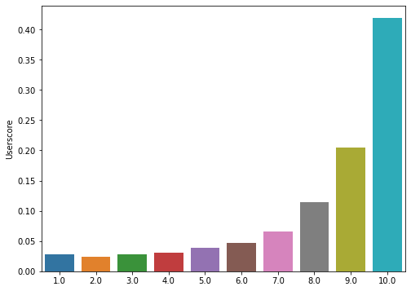
People are generous on ratings! D
People do rate differently.
Distribution of Userscore

Slide 5
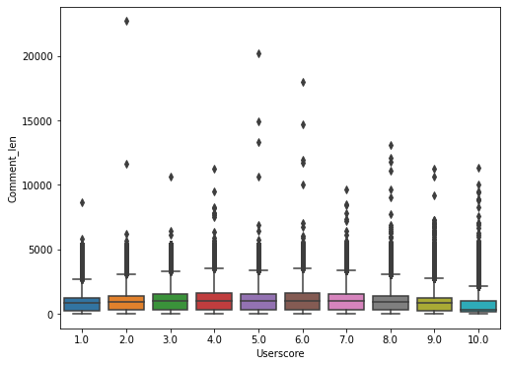
people tend to
give good score
But comment more
on lower score
Distribution of Comment Length
Based on user score
Notes:
People do think differently!

Slide 6
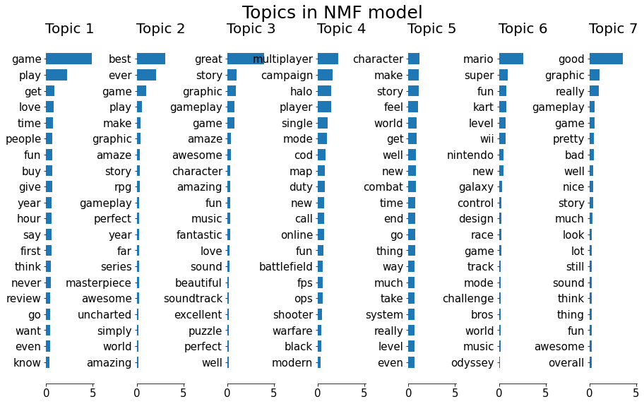
Top words from metacritic topics
Notes:
Many good words
Some special ones

Slide 7
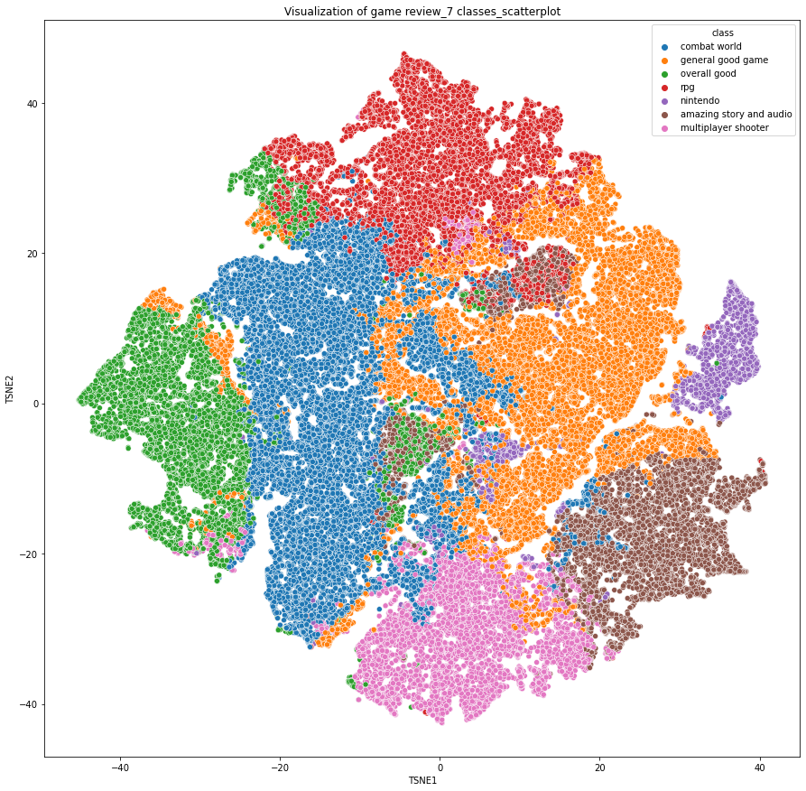
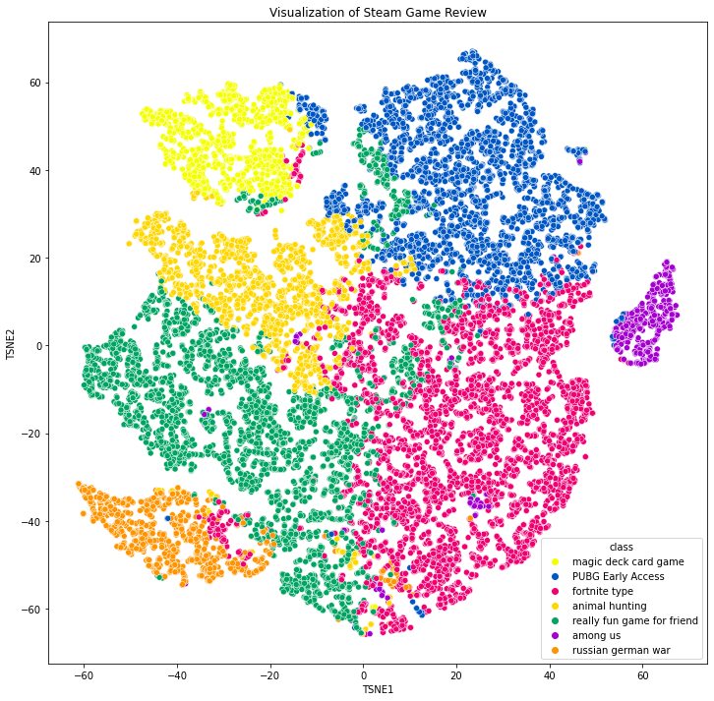
metacritics
steam
Topics from different sources can form clusters

Slide 8
Sentimental Analyzer

Slide 9
NLP MODELS
30% data (70569 reviews)
160~ vocabulary size
Baseline
MODELS | MSE | MAE | TRAINING TIME
random forest | 4.52 | 1.52 | 24m
xgboost | 4.57 | 1.59 | 14.6s
Tensorflow | 4.35 | 1.49 | 26.1s
Notes:
Score: similar, tf better
Give up random forest

Slide 10
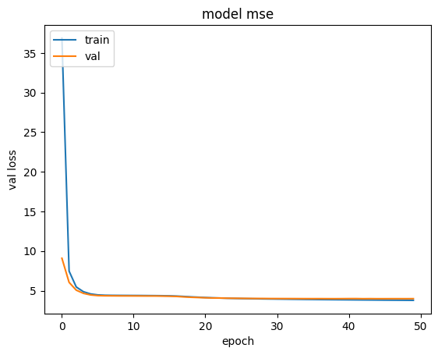
Tensorflow
100% data (235301 reviews)
baseline
Vocabulary size | MSE | MAE | R2 | Training Time
100 | 4.48 | 1.53 | 0.25 | na
200 | 4.07 | 1.45 | 0.32 | 25.5s

Slide 11
XGBoost
Increase vocabulary size from 160 to 5000
Baseline
30% data (70569 reviews) | 100% data (235301 reviews)
Percentage sample | Vocabulary size | MSE | MAE | R2 | Training Time
30% | 160 | 4.52 | 1.58 | 0.24 | na
 | 1000 | 3.99 | 1.47 | 0.33 | 26.1s
 | 5000 | 3.95 | 1.47 | 0.34 | 31.5s
100% | 5000 | 3.93 | 1.46 | 0.34 | 113.8s
Notes:
Speed
160-1000-5000 voc size
FUN FACT: With 2,500 to 3,000 words, you can understand 90% of everyday English conversations
30-100

Slide 12
Recommendation system
Notes:
Now I got my model,... if improve rec sys

Slide 13
MODEL COMPARISON
SVD and KNN
XGB and tensorflow model to impute
MODEL | RMSE
 | NO impute | XGB impute | TF impute
SVD (tuned) | 3.98 | 3.896 | 3.898
KNN (baseline) | 4.03 | 3.937 | 3.940
Improved!
So close!
Notes:
Every tiny bit counts! It’s money!

Slide 14
Future approach
Improve sentimental analyzer models
Improve recommendation system models
Collect more data
Merge to a RNN neural network

Slide 15

Thanks!
www.linkedin.com/in/viviannayan/
github.com/vivyhasadream
www.youtube.com/user/ViviannaYan
www.viviannayan.com

